Slide 1
Module 3: Bootstrap

Slide 2
Bootstrap
OBJECTIVES
1
T
To equip students with the basic understanding of Bootstrap framework and its features
2
Students will learn to design the page layout using Bootstrap’s grid system
3
To design responsive web pages by including different UI Components using Bootstrap framework

Slide 3

Bootstrap
OUTCOMES
At the end of this module, students are expected to learn
Design a responsive layout for a webpage using container, row & column classes of Bootstrap
Develop webpages that can be viewed on various devices using grid system of Bootstrap
Build applications which facilitates slideshow component for cycling through elements – like a carousel

Slide 4


Bootstrap
Document/Video Links
Topics | URL
Learning Bootstrap 4 in 30 minutes | https://medium.freecodecamp.org/learn-bootstrap-4-in-30-minute-by-building-a-landing-page-website-guide-for-beginners-f64e03833f33
Bootstrap official documentation | https://getbootstrap.com/docs/4.3/getting-started/introduction/
Learning Bootstrap | https://pepa.holla.cz/wp-content/uploads/2015/10/Learning-Bootstrap.pdf
Bootstrap Tutorials | https://www.youtube.com/watch?v=gqOEoUR5RHg https://www.youtube.com/watch?v=aTLRdrRQyN4&vl=en https://www.youtube.com/watch?v=hnCmSXCZEpU

Slide 5

Content
Introduction
Page Layout
UI Components
Responsive Web Design

Slide 6
Introduction
Need of Bootstrap
In spite of various advantages of CSS, it has certain disadvantages as well
Level of compatibility
Certain CSS features may not be supported by some browsers (appearance can be non uniform at different platforms)
Difficult to manage & maintain large applications as per the varying browser compatibility
Website responsiveness

Slide 7

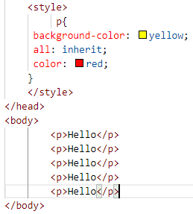
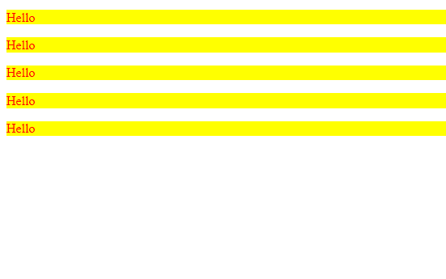
Introduction
What’s Browser Compatibility?
E.g. consider the following code
On google chrome
On IE

Slide 8
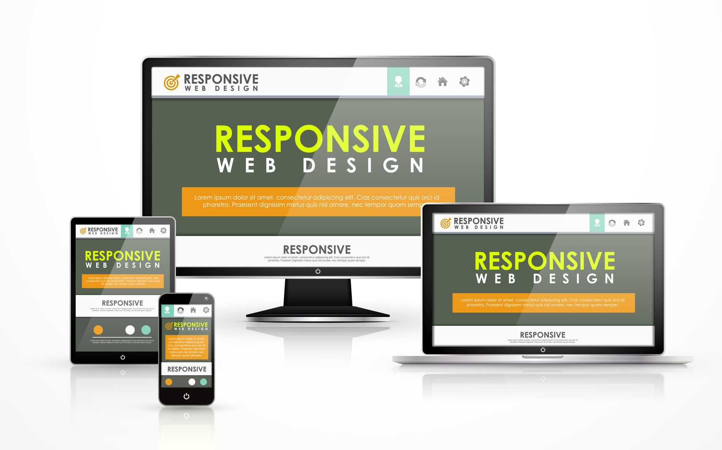
Introduction
Responsiveness
A responsive web design is all about providing an optimal viewing experience across variety of devices
A web page should maintain its appeal, when it is viewed in a mobile/tablet or a desktop

Slide 9
Introduction
Bootstrap
was built at Twitter Inc. by Mark Otto and Jacob Thornton as a framework for internal tools
is a complete CSS framework offering Grid system and configurations, Typography classes, UI components like forms, tables and much more
is a widely used framework in the development of responsive websites
has a very good documentation which can be found here

Slide 10
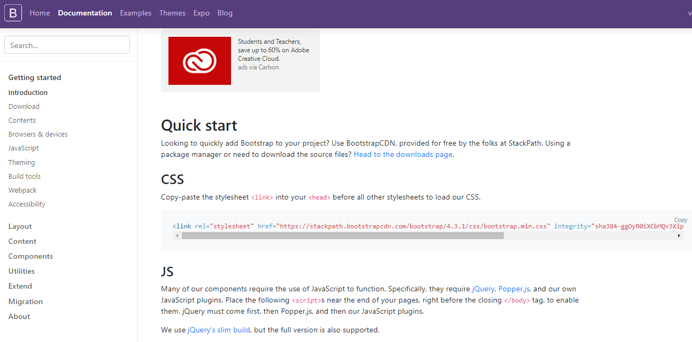
Introduction
Getting Started!
Before going ahead, copy the “bootstrap.min.css” file from the website GetBootStrap.com into your html
Click on “Get Started” & copy the link given under CSS section
Paste it under the <head> section of your html file

Slide 11
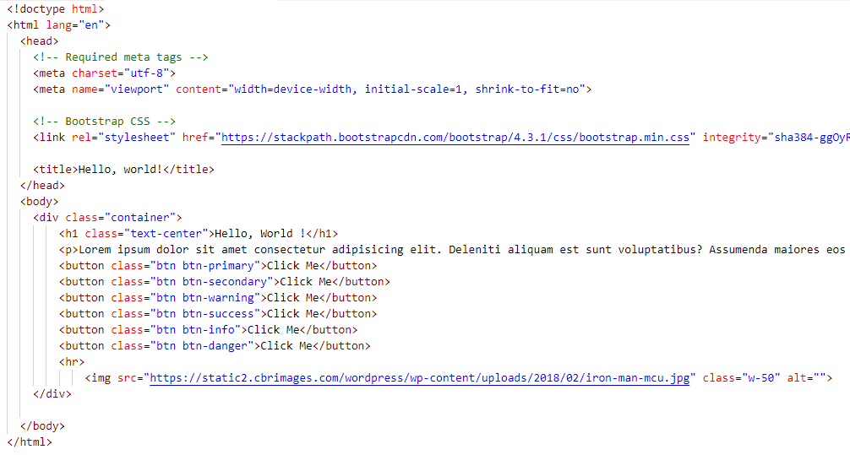
Introduction
Sample Example

Slide 12
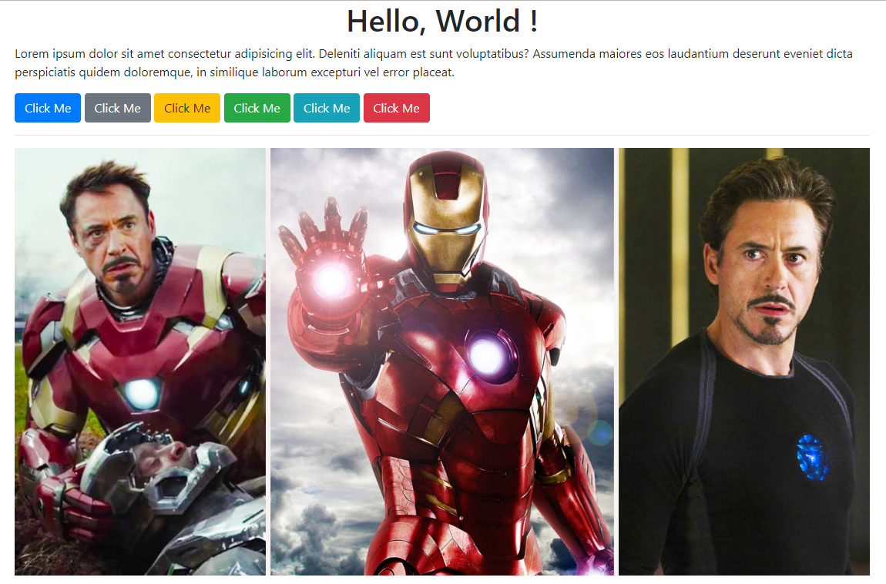
Introduction

Slide 13
Page Layout
Container Classes
To properly place the content in a webpage, Bootstrap needs a containing element to wrap the page contents
Bootstrap provides two types of container classes
.container : fixed width responsive container (as in CSS3)
.container-fluid : full width responsive container, utilizing the entire width of the browser/viewport

Slide 14
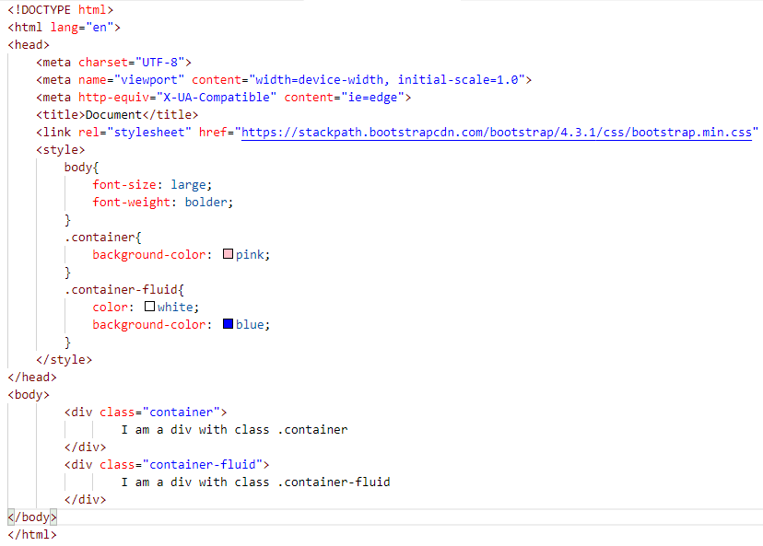
Page Layout
Containers
E.g.

Slide 15
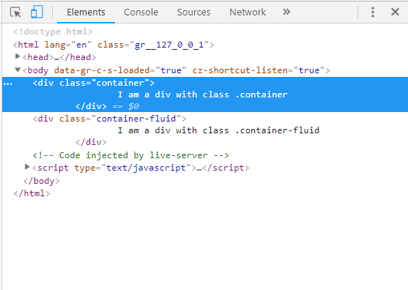
Page Layout
Containers
Run the above code on Live Server & right click & select “inspect element”
Click on the mobile icon

Slide 16
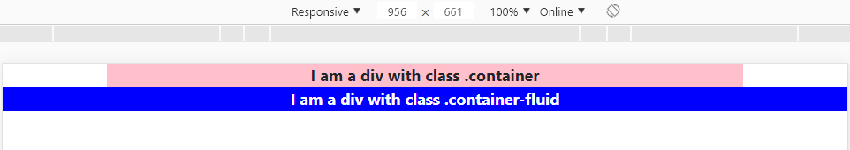
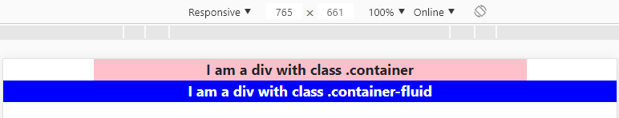
Page Layout
Containers: Output

Slide 17
Page Layout
Self Assessment Quiz
Which of the following is/are not among the features of Responsive Web Design?
Fluid Layout
Flexible Images
Typography
Calligraphy
Answer: d

Slide 18
Page Layout
Self Assessment Quiz
2. Which among the following code gives me a fixed width container?
&lt;div class="container-fluid"&GT; &lt;/div&gt;
&lt;div class="fixed-container"&GT; &lt;/div&gt;
&lt;div class="container"&GT; &lt;/div&gt;
&lt;div class="fixed"&GT; &lt;/div&gt;
Answer: c

Slide 19
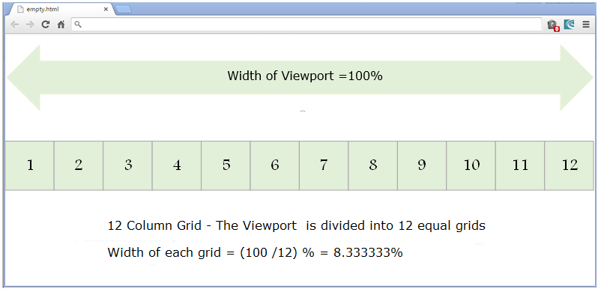
Page Layout
Grid System
In Bootstrap, each webpage can be divided into rows and column-grids, and each row has 12 column-grids

Slide 20
Page Layout
Grid System: Column Classes
To create a column in Bootstrap, .col-<sq>-<n> class needs to be used
Here <sq> is the size qualifier and <n> is the number of grids we want the column to occupy
Size qualifiers can be of four types:
lg (for large devices with screen width >= 1200px)
md (for medium devices with screen width < 1200px and >=992px)
sm (for small devices with screen width < 992px and >=768px)
xs (for extra small devices with screen width < 768px)
Number of grids in a column can range b/w 0 to 12

Slide 21
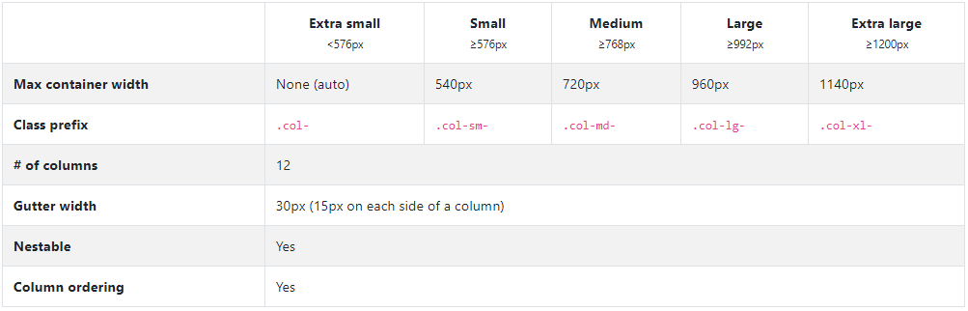
Page Layout
Grid System: Column Classes

Slide 22
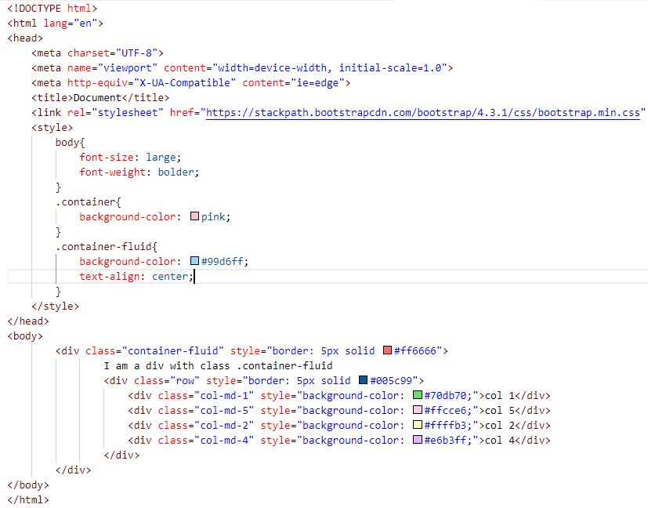
Page Layout
Grid System: Column Classes
E.g.
Column width for medium devices with grid size equal to 12

Slide 23
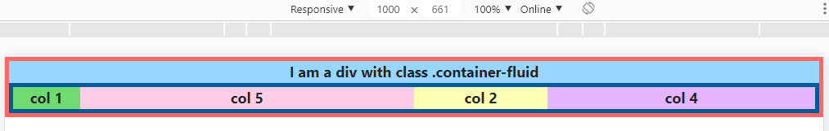
Page Layout
Grid System: Column Classes
Output
Grid size 1
Grid size 5
Grid size 2
Grid size 4

Slide 24
Page Layout
Self Assessment Quiz
Which of the following will give an equal column grid system?
<div class="col-md-4"/>
<div class="col-md-4"/>
<div class="col-md-4"/>
b. <div class="col-md-2"/>
<div class="col-md-3"/>
c. <div class="col-md-2"/>
<div class="col-md-2"/>
<div class="col-md-2"/>
Answer: a & c

Slide 25
Page Layout
Self Assessment Quiz
2. Which among the following will result in overflow?
<div class="col-md-6"/>
<div class="col-md-3"/>
<div class="col-md-4"/>
b. <div class="col-md-3"/>
<div class="col-md-3"/>
<div class="col-md-6"/>
Answer: a

Slide 26
UI Components
Navigation Bar
Navigation bar (navbar) is a section intended to aid users in accessing different webpages of a website
HTML5 provides us with <nav> element to create a navigation bar
Bootstrap has different classes which help to provide better appearance to the navbar
A responsive navbar collapses when viewed on smaller screens, expands otherwise (to achieve this feature, apart from bootstrap.css, bootstrap.js and jquery.js are also required)

Slide 27
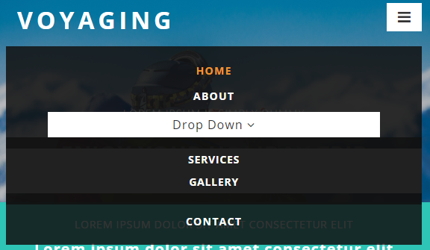
UI Components
Navigation Bar
On larger screens
On small screens
Hamburger menu

Slide 28
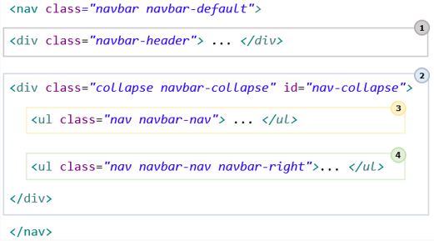
UI Components
Navigation Bar
Basic skeleton of a navigation bar in Bootstrap is as follows:
Brand name & Toggle button
Head to getbootstrap.com
Under Components section, select “Navbar”
All nav links
Left side nav links
right side nav links

Slide 29
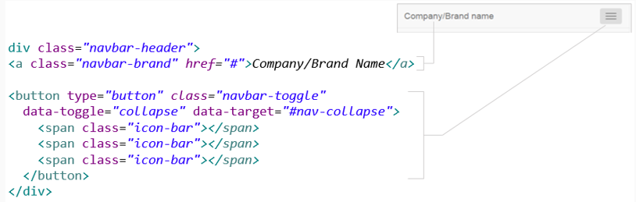
UI Components
Navigation Bar
Creating the toggle button (adding responsiveness)
Tells bootstrap to switch b/w visual states by collapsing according to the device width

Slide 30
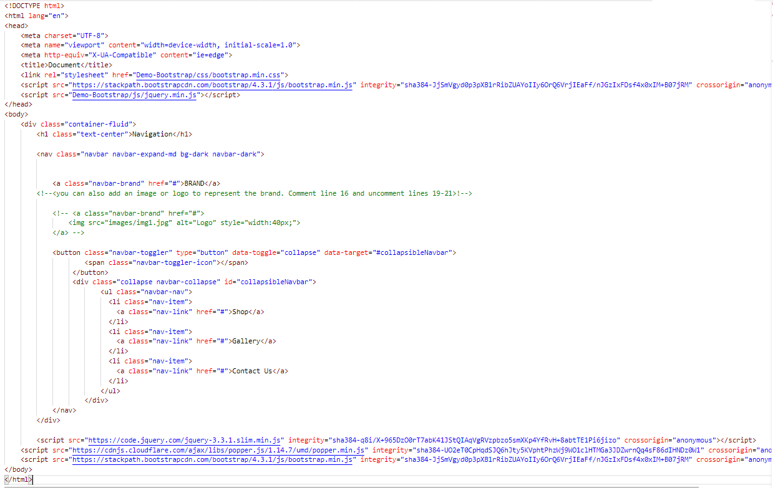
UI Components
Navigation Bar
Demo E.g.
Go to getbootstrap.com
Under “Getting Started” section, copy the JS code given

Slide 31
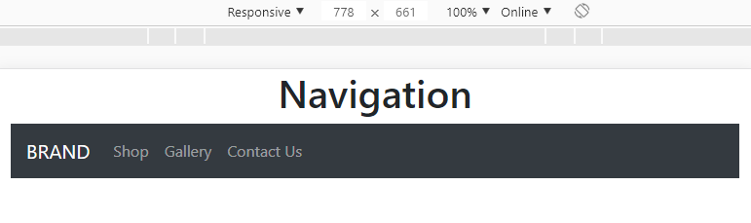
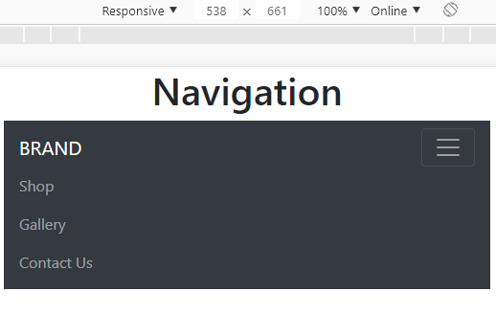
UI Components
Responsive Navigation Bar
Output
On small screens

Slide 32
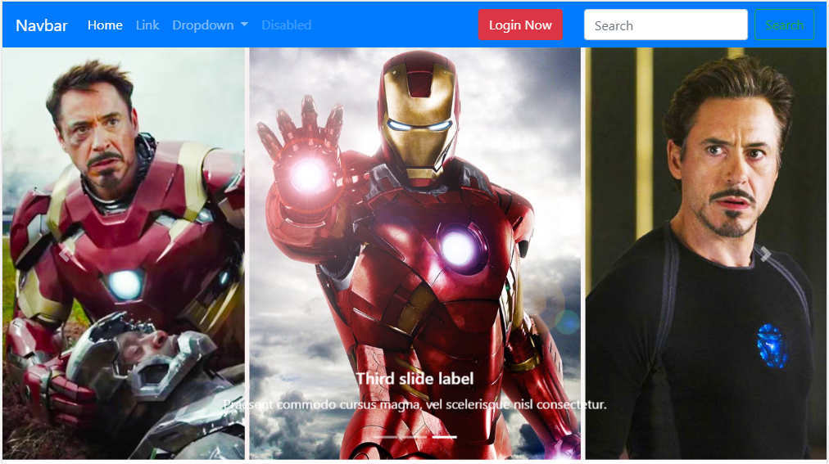
Responsive Web Design
Clickable Login Form using
“Button Trigger Modal”
Demo Responsive Web Design
Toggle Navbar
carousel

Slide 33
Thank You

